Slide 1
Unethical and Bad Questions Detection by using Machine Learning Techniques
Presented by
1.Lokesh Naidu Bavigadda
2.Vamsi Krishna Chittimadha
3. Sri Sai Bhargava Kakarlapudi
4.M Manikanta Venkata Satya Raghu Ram Pasumarthi

Slide 2

AGENDA
1.Data Set
2. Data Cleaningand Analysis
3.Implementations
4.Preliminary Results

Slide 3


Data Set
It has a non-neutral tone
2.It is disparaging or inflammatory
3.It is not grounded in reality
4.Uses Sexual content for shock value and to seek genuine answers

Slide 4
Data Preprocessing and Analysis
It comes under data cleaning
At first we removed numbers
Replace repetations of punctuations
Remove punctuations
Replace Contractions
Lowercasing of letters
Replace Negations with Antonyms
Remove Stop words
Replace Elongated Words
Stemming/Lemmatizing
TFA-Vector

Slide 5
ANALYSIS:
1.Syllable analysis
2.Lexican Analysis
3.Question Length
4.Average Syllables per word in a question
5.Average letters per word in a question

Slide 6
Implementation:
1.After performing Data cleaning, we used tfidf vectorizer to get better model results for text based data sets
2.Here, we used sklearn library for a builtin function of tfid vectorization and
3.Here, we used k fold validation , it helps to prevent overfitting and easy to reliable for a best model.
4. So here , we used 5 splits in k fold validation and trained one algorithm called logistic regression.

Slide 7
Explanation of Model:
1.Here, we used logistic Regression model, it is a Statistic model, also known as logit model.
2.It is used for classification and predictive model.
3. Logit(pi) = 1/(1+ exp(-pi))
ln(pi/(1-pi)) = Beta_0 + Beta_1*X_1 + … + B_k*K_k4.
4.In above equation,logi-pi is independent to responsible variable and x is independent variable, the beta parameter is likely estimated via maximum likely hood s function, optimal coefficient will be found

Slide 8
Linear Regression Model:
Three types of models
1.Binary logistic Regression
2.Multinomial logistic Regression
3.Ordinal logistic Regression

Slide 9
LOGISTIC REGRESSION MODEL:
1.In Binary logistic regression. The dependent variable is independent in nature it has only two outcomes.
2.That means a binary outcome . For example, it used to predict whether the email is spam or not or whether is to hack or not, this is the widely used example to explain logistic regression.
3.In Multinomial logistic regression. There are three outcomes.
4.Example to understand what type of drink consumers prefer based on location and the age. Or three based regression.
5.The last one is ordinal logistic regression. This logistic regression model is used to response variable that has more than three outputs.
6.These values do have order. For example movies rating that can be between 0 to 5.

Slide 10
PRELIMINARY RESULTS:
1.Here we used evaluation metric as F1 score from sklearn library for evaluating model’s performance.
2.It tells how many times our model gives correct prediction for our entire dataset
3. It uses precision and recall scores of model and computes it

Slide 11
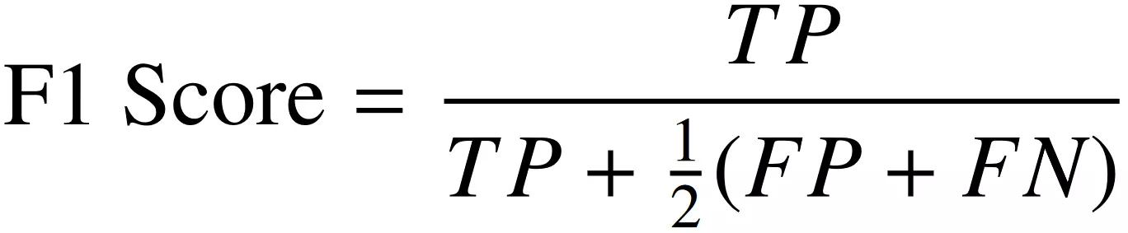
EVALUATION METRIC:
1.
2. We got F1 score as 0.59
3. In increment 2 we are going to explore different models to get more result than present result

Slide 12
WORK TO BE COMPLETED:
Has a scope in advanced data cleaning where the model can easily converge for a better results
Looking for more analytical methods and statical methods for the good understanding of the dataset. Where a lot of change will be there for model selection which has to bt trained
Deep learning models can be used here for the better converging results
Machine Learning models such as MultinomialNB and BernoulliNB will be trained
Hyperparameter tuning should be done for the models for a better features for an algorithm

Slide 13
Team Roles
Our team consists of four members Lokesh, Vamsi, Bhargava, Manikanta
Where Lokesh and vamsi contributed in data cleaning activites and data selection activities
Bhargava and manikanta did analysis of the dataset and came out the insights for the better understanding of the dataset
The basic preliminary model was developed by Vamsi.
And Bhargava and Manikanta documented the work for increment 1

Slide 14
Thank you

